Slide 1
DCAF Debugging

Slide 2
Agenda
Basics RT Debugging
Debugging Reentrant Vis.
Running modules outside of the Engine.
Syslog
Tag View
CVT

Slide 3
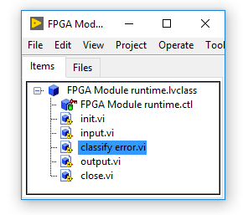
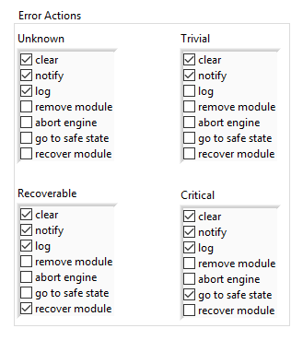
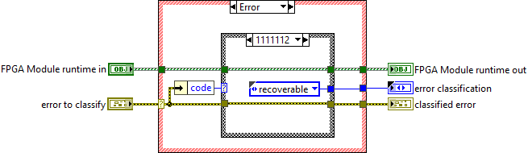
Error Management

Slide 4

Syslog
Available in Linux RT Targets
Event sent to Log:
Initialization and shutdown of all software modules
Any error reported to the engine
Any module trace messages added via the API

Slide 5
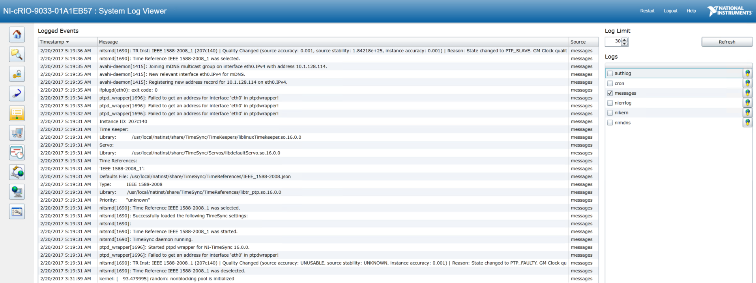
Syslog - System Log View

Slide 6
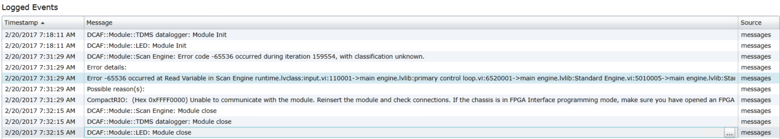
Syslog - System Log View

Slide 7
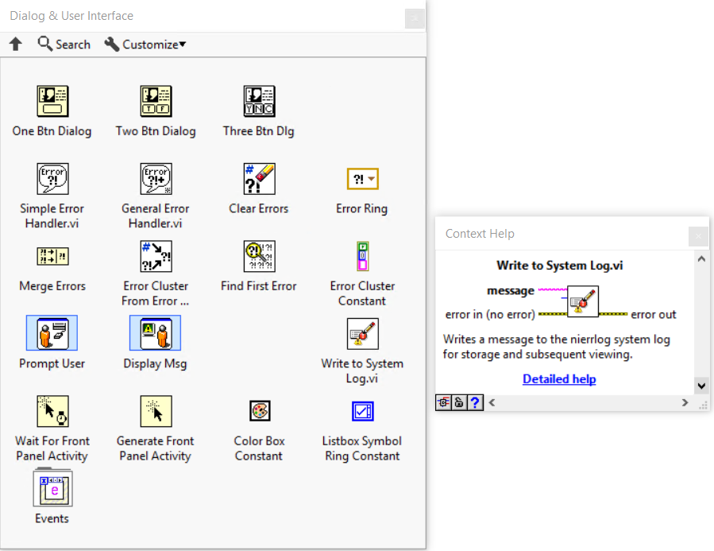
Syslog
NI Linux RT targets already have a syslog-ng daemon running
DCAF taps into the existing background process to log and report messages
You can, too!
Notes:
Add WIF

